Slide 1
Predicting Water Well Failures Using Machine Learning
Analysis by Brian Bentson

Slide 2
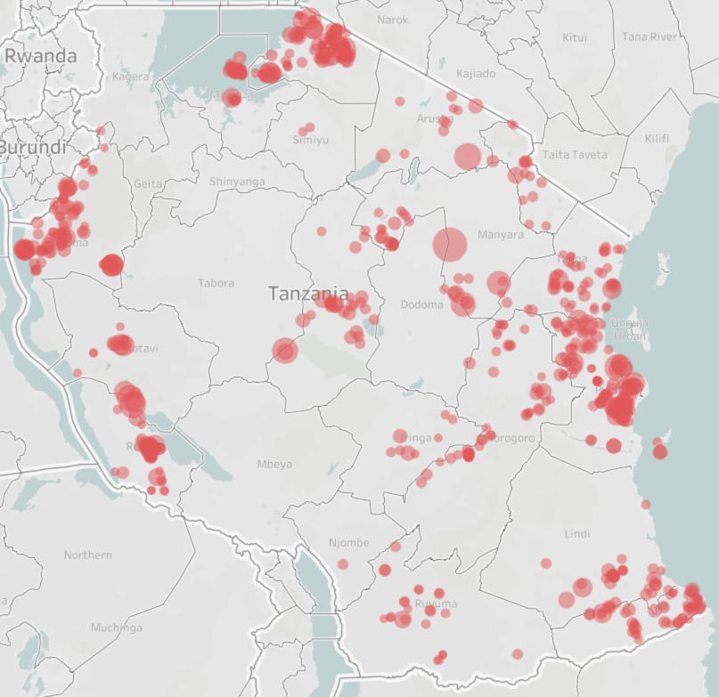
Predicting Well Failure Can Save Lives
Non-Functional wells that support over 1,000 citizens
(sized by population)
Tanzania has almost 60,000 water wells in dataset with 45% not functional, leaving almost 7M people without a reliable water source
Humans can only live up to 3 days without water
Ability to predict water well failures and respond quickly can be the difference between life and death
Tanzania

Slide 3
Data Quality a Potential Issue
18K
Almost 18,000 water wells with zeros for population, head, well elevation and construction year
Outliers and improbable values in the head that can skew results
Zeros in construction year were converted to years based on distribution of non-zero values

Slide 4
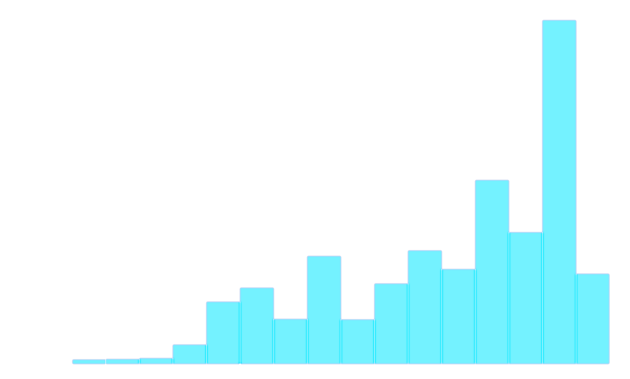
Analysis Overview
31,385
26,194
4k
Equated wells functioning at a reduced capacity as not functioning
Created well_age feature
Classification modeling to use well features to predict non-functional water wells can save lives by increasing reliability and maintenance response time
Functional
Functional
Non Functional
Functional Needs Repair
Non Functional
19k
Distribution of Well Construction Year
Random Imputation
12.5k
Well Count
5k
0
1955
2000
2015

Slide 5
Best Classification Modeling of Well Status
Prioritized Recall which prioritizes finding all well failures while maybe responding to wells which haven’t failed
Increased maintenance spend and resources required
Focused on models with high interpretability to understand what drives well failures
Best model was a Random Forrest with a Recall for detecting failures of 77%
Random Forrest

Slide 6
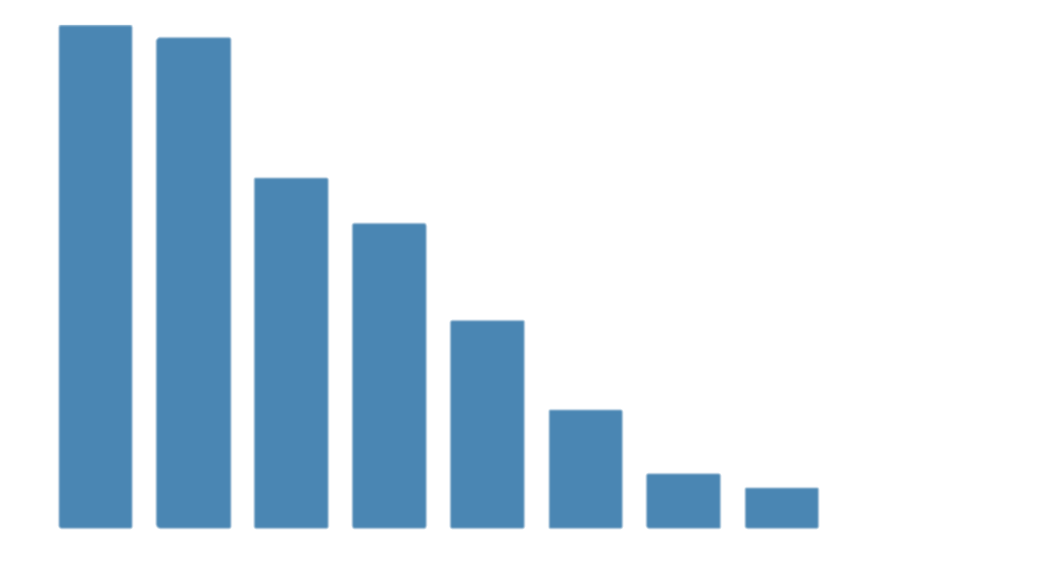
Most Important Features from Model
Longitude
Location (longitude and latitude) is the most important feature for predicting well function
Well age directly affects reliability
Well head directly affects water quantity
Well Elevation and Population are important features for prediction, although analysis did not highlight specific relationships
Latitude
Well Elevation
Population
Well Age
Head
Communal Standpipe
Multiple Communal Standpipe

Slide 7
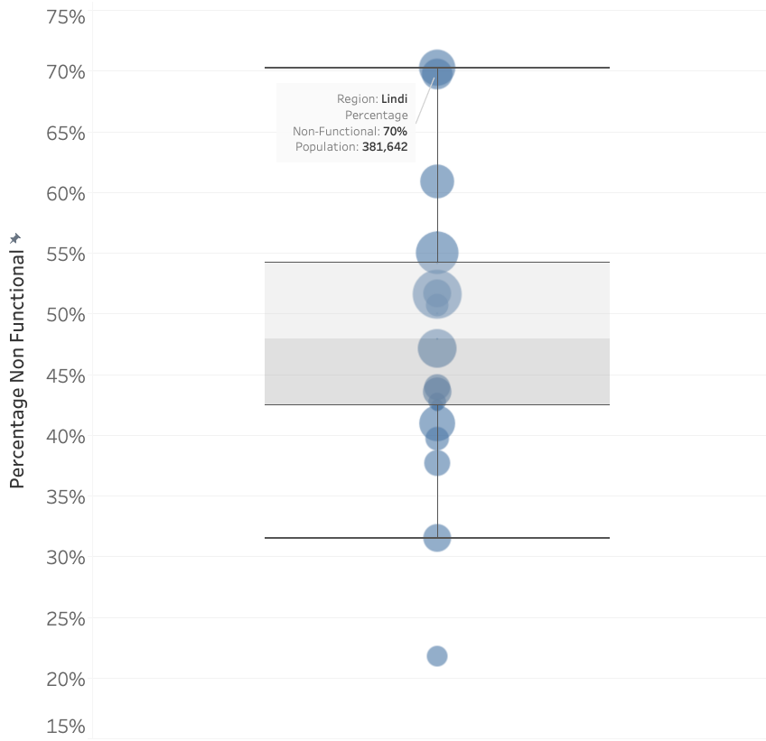
Location Affects Reliability
Distribution Percentage Non-Function by Region
High variability in well function across regions
Many Regions with high failure percentage and high population
Recommendation: Focus on regions which have historically high failure percentage

Slide 8
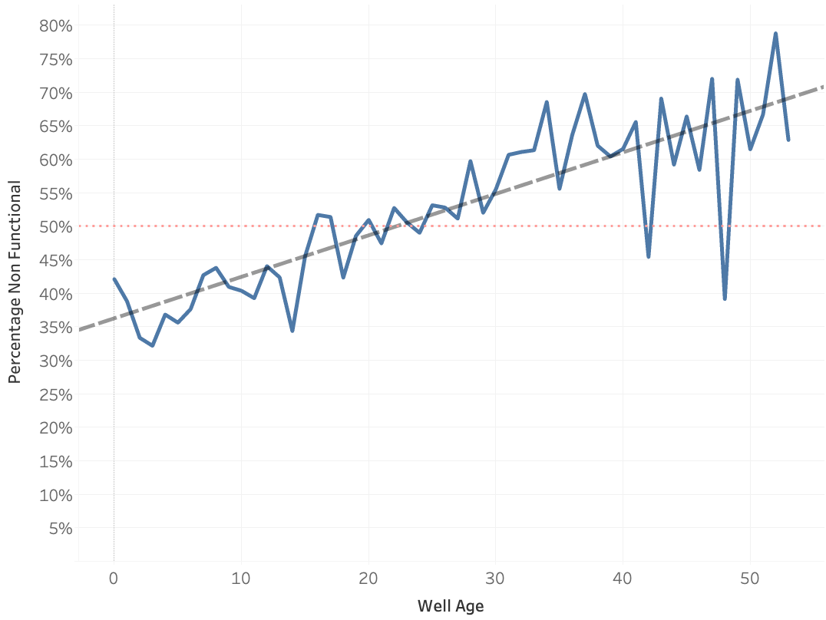
Well Age Negatively Affects Reliability
Percent Non-Functional by Age
As well ages increase, the percentage of non-functional wells increases
If a well is over age 24-25, it is more likely that well will be non-functional rather than functional
2.5M people are supported by older wells (>24 years old)
Recommendation: Focus maintenance on older wells to maintain supply of water

Slide 9
Lower Static Head Indicates Failure
31 FH
Amount of Static Head by Well Status
23 FH
As well ages increase, the amount of static head on the well will decrease, lowering water quantity
This can be artificially improved by technology such as a pump
Recommendation: Keep a close eye on static head as it directly correlates with water quantity
Amount of Static Head by Water Quantity
Functional
Non Functional
Enough
30 FH
Insufficient
28 FH
Seasonal
22 FH
Dry
18 FH
Unknown
16 FH

Slide 10
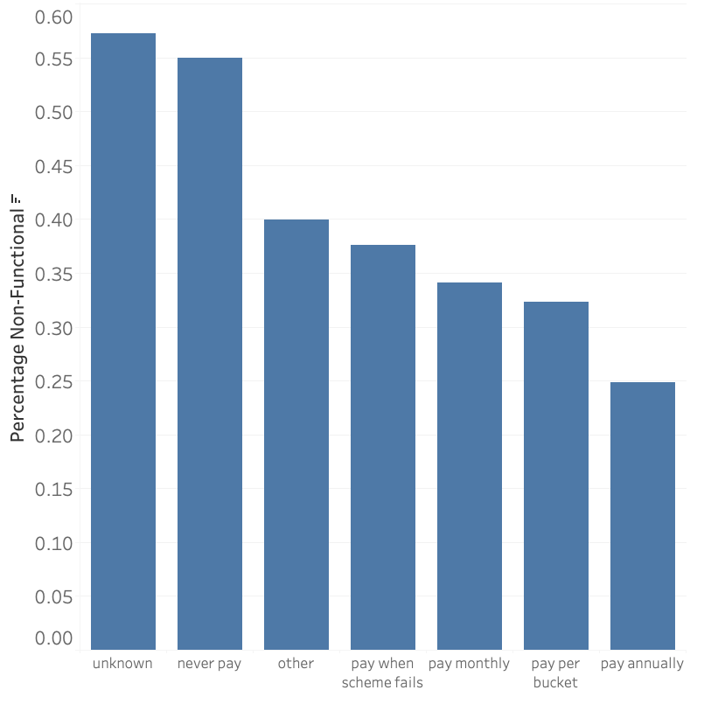
You Get What You Pay For
Distribution of Non-Functional Percentage by Water Cost
While not specifically important for the random forest model, there is a clear trend between showing that if you pay for the water, the wells reliability is higher
Recommendation: Focus on supporting the populations which cannot afford to pay for water

Slide 11
Recommendations & Next Steps
Recommendations
Develop a relationship with locals in order to establish a frequent communication protocol to ensure if water quantity drops, maintenance management companies get notified as soon as possible.
Develop support model for population areas that do not pay for water since analysis shows paying for water brings better reliability
Improve data governance to ensure better data quality and better predictions
Next Steps
Use more sophisticated algorithms that may perform better at finding well failures but does not tell you why they are failing
Develop Impact Rating Dashboard
Notes:
The estimates for full bathroom square feet from an online search for ”average full bathroom size”.

Slide 12
Thank you
Questions?

Slide 13
BACKUP

Slide 14
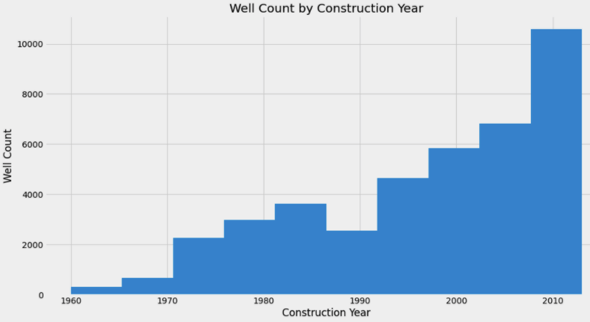
Analysis Overview
31,385
26,194
Focused on wells not functioning or functioning at a reduced capacity (functional needs repair)
Created well_age feature
20,000 wells with unknown construction_year. Filled values keeping identical distribution
Classification modeling to use well features to predict non-functional water wells can save lives by increasing reliability and maintenance response time
4k
Functional
Functional
Non Functional
Functional Needs Repair
Non Functional

Slide 15
Non-Functional wells that support over 1,000 citizens
(sized by population)
Tanzania

Slide 16
Most Important Model Features
Longitude
Latitude
Well Age
Well Elevation
Population
Head
Communal Standpipe
Multiple Communal Standpipe

Slide 17
Percentage of Non-Functional Wells by Region

Slide 18
475 FH
150 FH
Amount of Static Head by Well Status
Functional
Non Functional
Amount of Static Head by Water Quantity
Enough
426 FH
Insufficient
260 FH
Dry
135 FH
Seasonal
116 FH
Unknown
68 FH

Slide 19
Percent Non-Functional by Well Age

Slide 20
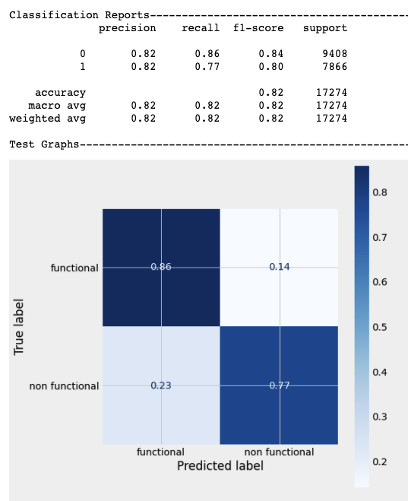
Random Forest Model Results

